Slide 1
MOBILE APPLICATIONS DEVELOPMENT
Gitungo Natasha Wangari

Slide 2
Motivation
The Play Store apps data has enormous potential to drive app-making businesses to success. Actionable insights can be drawn for developers to work on and capture the Android market!
For instance developers are able to understand which category of apps are the most downloaded?
Do potential customers want large or smaller apps?
Which category of apps are the most expensive in the development industry today?

Slide 3
Research Question(s)
What features should mobile application developers focus on to attract the most clients?
What determines whether a potential customer will download and install your application or not?
Mobile application developers are determined to develop applications that are useful to people while making them readily available to the market.In order to develop such apps, we need to understand what features our market is looking for in applications and how to attract downloads.

Slide 4
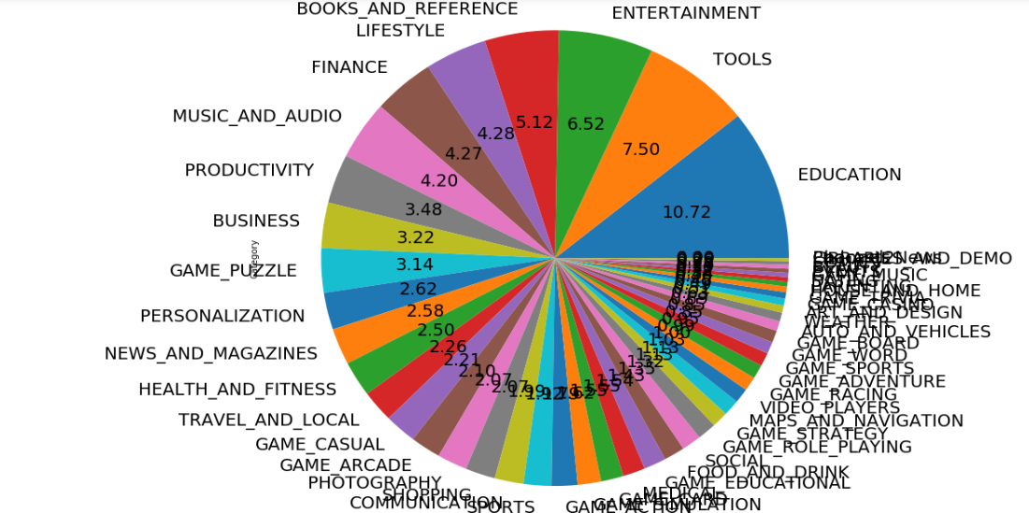
Categories of apps distribution

Slide 5
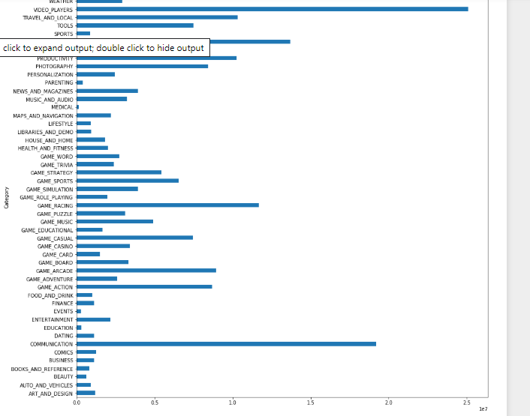
Which category has the most installs?

Slide 6
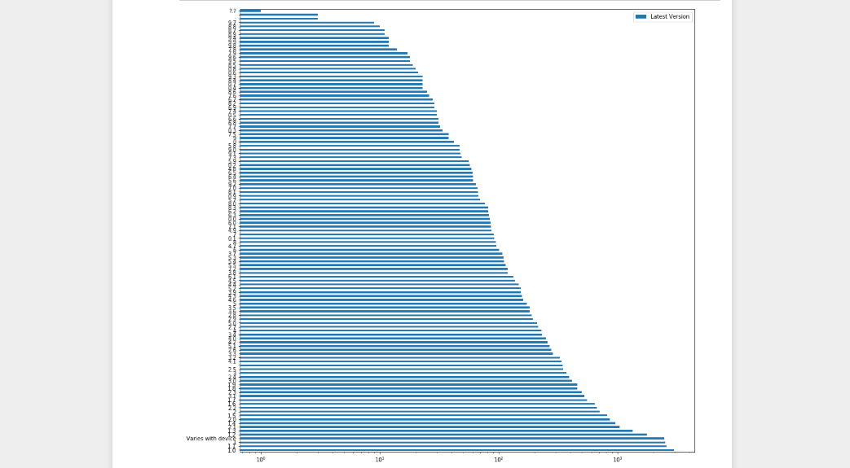
Latest Version distribution

Slide 7
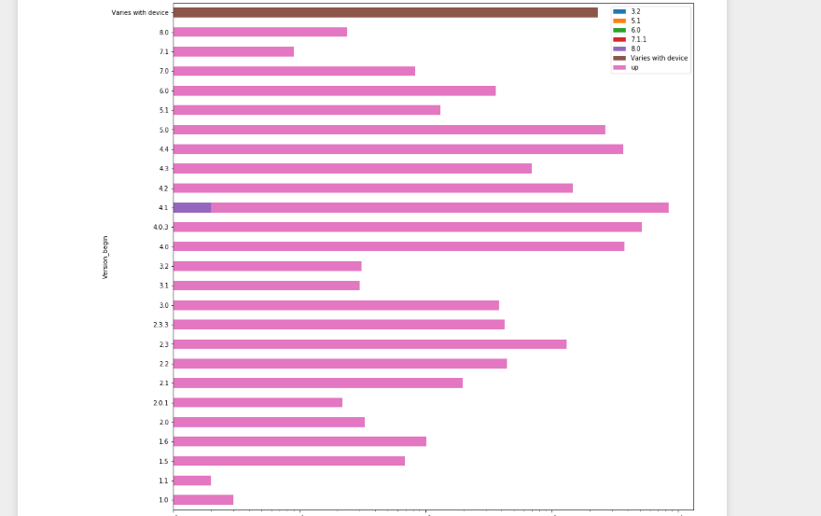
Upgrade of version distribution

Slide 8
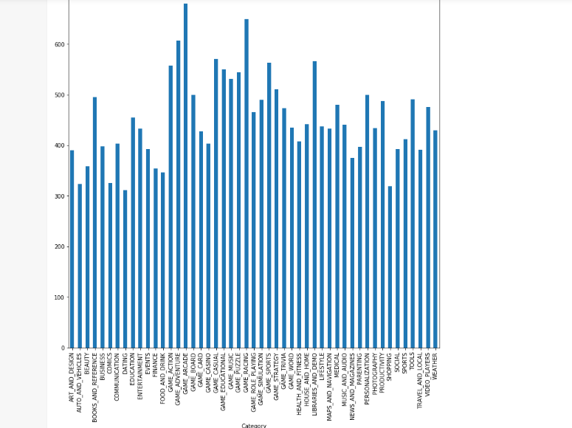
Which category of apps is most frequently updated?

Slide 9
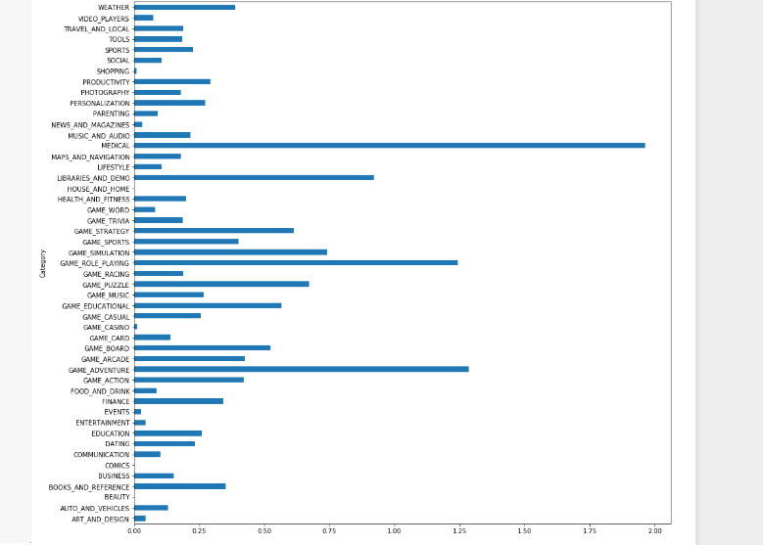
Which category of apps have the highest installs?

Slide 10
Which category of apps are the most expensive?

Slide 11
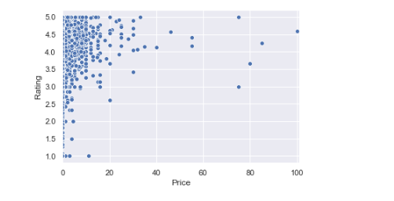
Do expensive apps have good ratings?

Slide 12
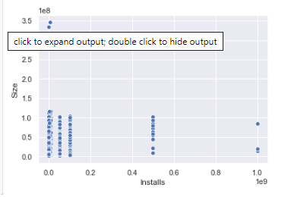
Do largely sized apps get many downloads?

Slide 13
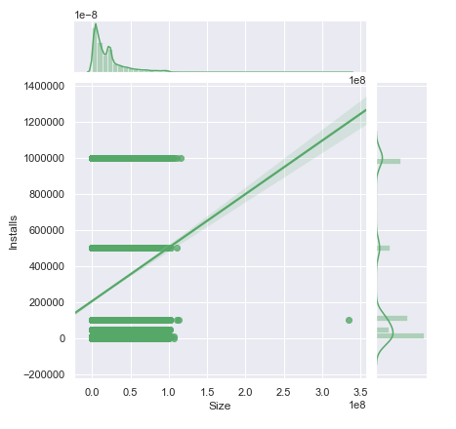
Linearity between installs and size of app

Slide 14
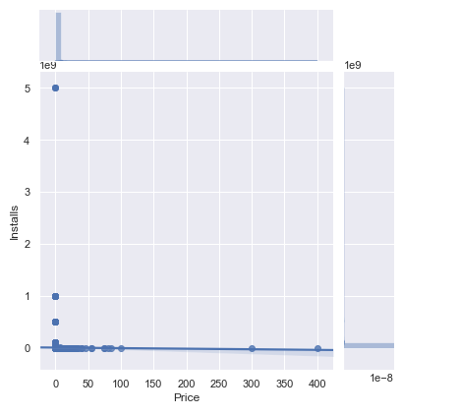
Linearity between number of installs and price of an app.

Slide 15
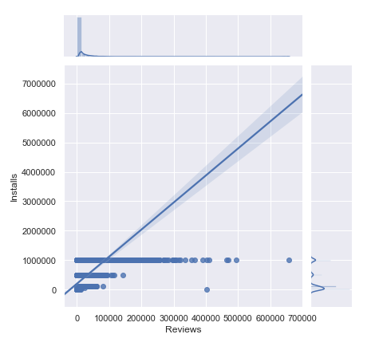
Linearity between number of installs and reviews of an app.

Slide 16
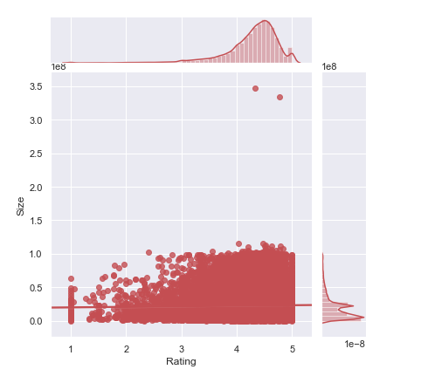
Linearity between size and rating an app receives.

Slide 17
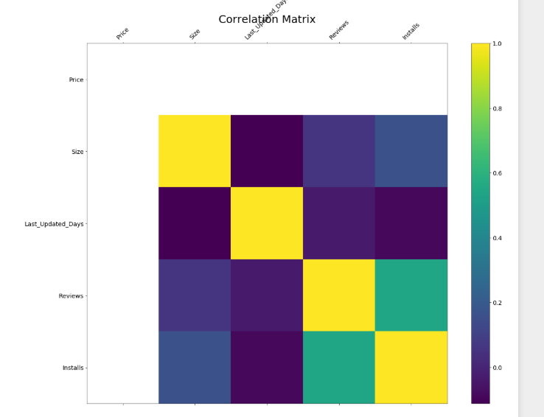
Correlation Matrix of selected features

Slide 18
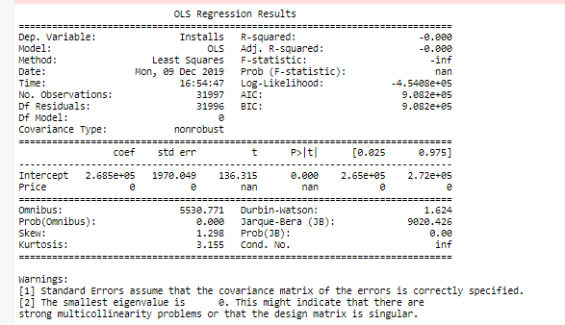
Linear Regression model Analysis

Slide 19
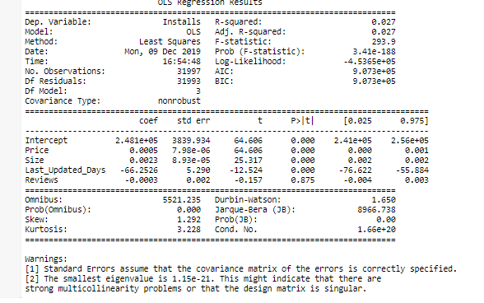
Multiple linear regression analysis

Slide 20
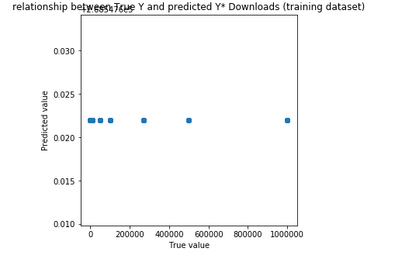
Training dataset predictions using linear model

Slide 21
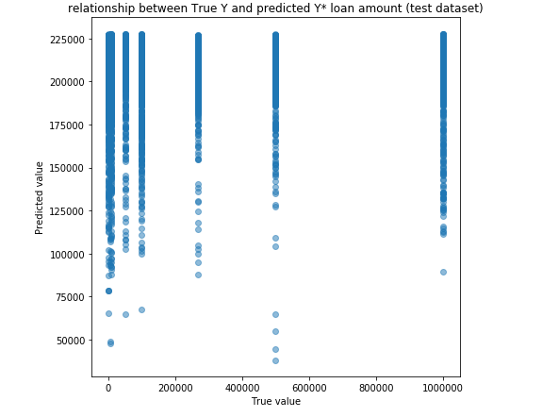
Test dataset predictions using linear model

Slide 22
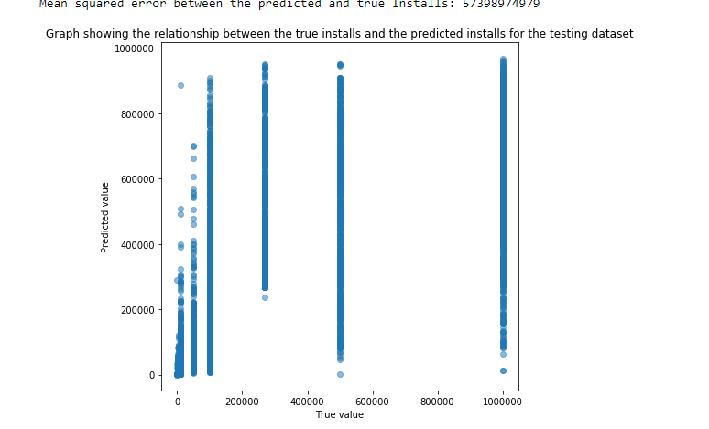
Test dataset predictions using Random Forests Model
Train score: 0.9999134951363001
Test score: 0.19619903117305582

Slide 23
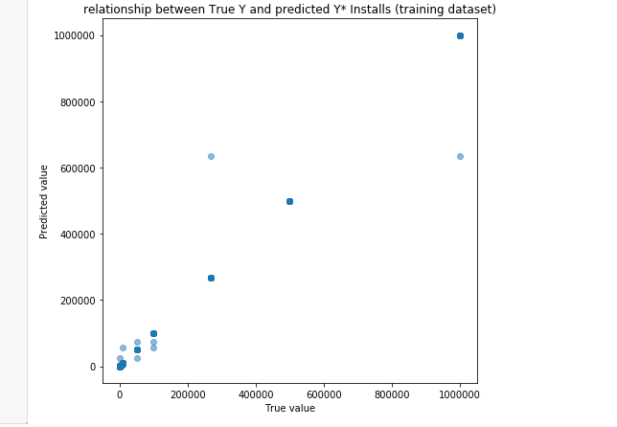
Training dataset predictions using Decision trees model
Train score: 0.9999134951363001
Test score: 0.19619903117305582

Slide 24
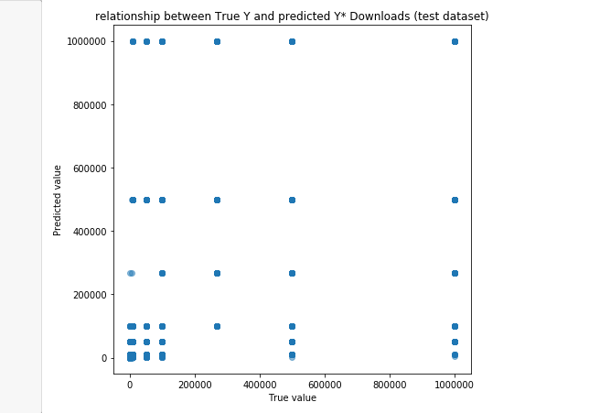
Test dataset predictions using Decision trees model

Slide 25
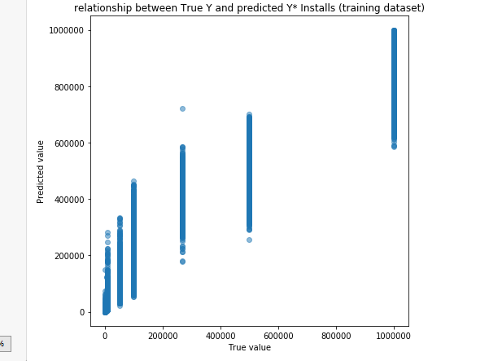
Training dataset predictions using bagging regression

Slide 26
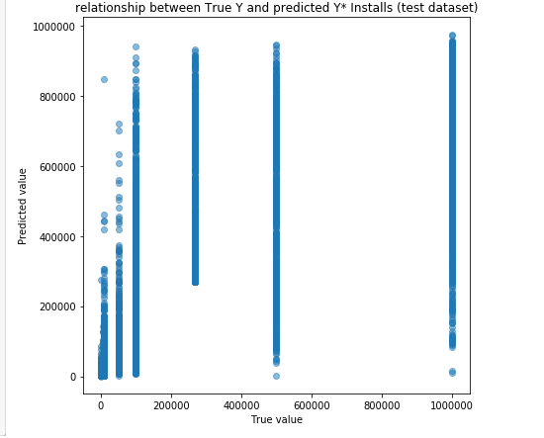
Test dataset predictions using bagging regression
Train score: 0.9156084658446273
Test score: 0.5073717389642847
Oob score: 0.41101788456134714

